Slide 1

Activation Function

Slide 2
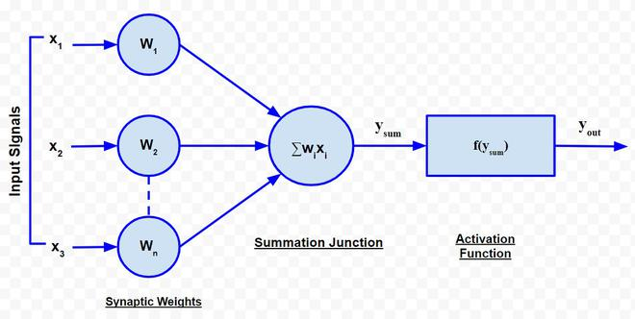
Definition
Activation function is internal state of neuron, give one output. Used to convert the input signal on node of ANN to output signal.

Slide 3
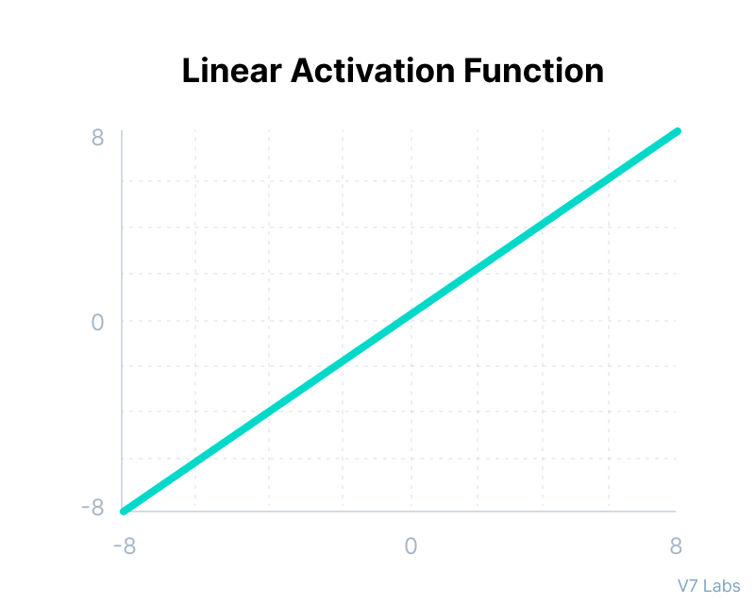
Identity or Linear Function
Why use?
When?
Output is same as input.
Identity function is f(x)=x.
The derivative of the identity function is always 1. This simplifies backpropagation since the gradient does not change the weight updates.
When the neural network is intended to output a continuous variable directly, using the identity activation function in the output layer is appropriate.
Regression tasks

Slide 4
Identity or Linear Function - Example
Suppose you are building a simple neural network for a basic linear decision-making task, like determining if an object's weight exceeds a certain threshold.
Utilization of Identity (Linear) Function:
Output Layer: Use the identity (linear) function in the output layer.
Reason: The identity function simply outputs the input value without any transformation. It is suitable for tasks where a direct mapping from input to output is required, without any non-linear transformation.
Why Identity (Linear): Ideal for tasks where the output needs to be directly proportional to the input or when no non-linear transformation is desired.
Why Not Others:
Sigmoid/ReLU/Tanh/Softmax: Provide non-linear transformations that are unnecessary for this simple linear decision-making task.

Slide 5
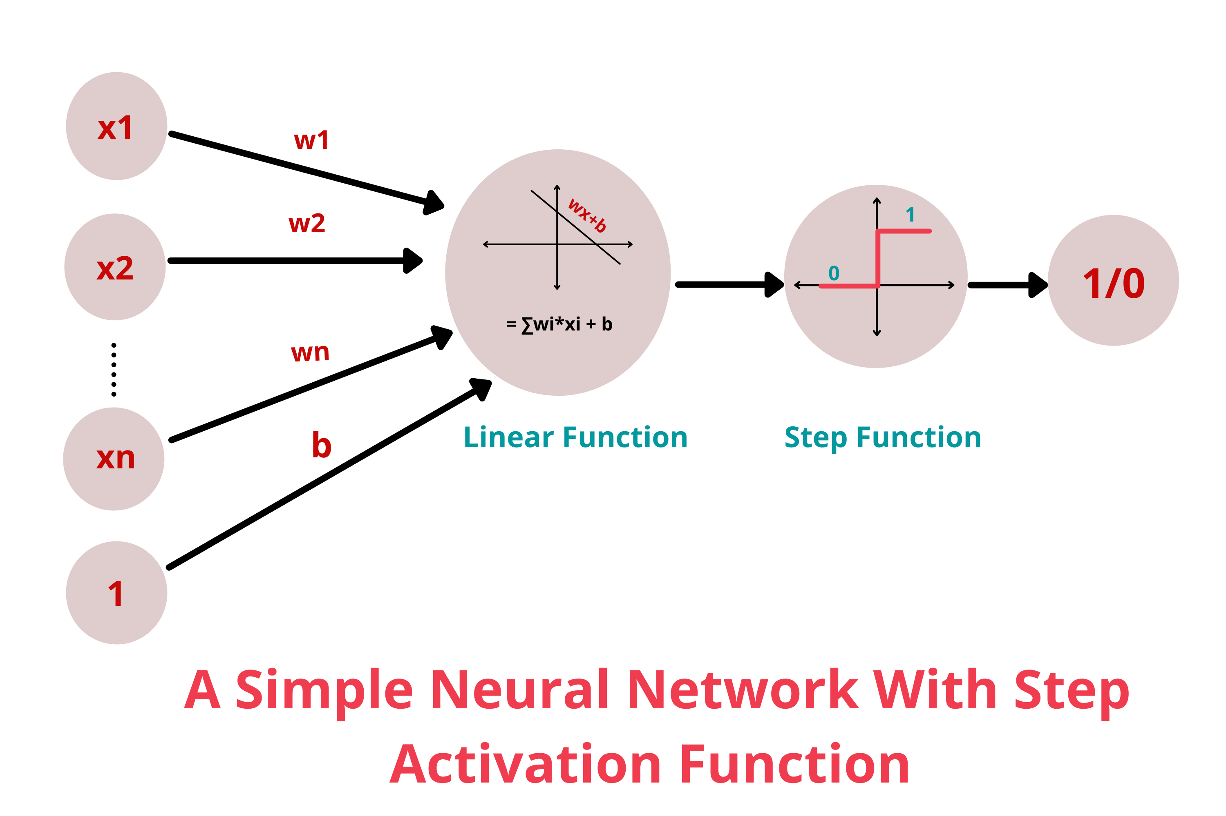
Binary step Function
Why use?
When?
Output either 0 or 1.
Function f(x) =1 if x>=0 and 0 if x<0
The binary activation function is not differentiable at x=0 and has a zero gradient almost everywhere.
Tasks that inherently involve thresholding, such as certain types of signal processing or pattern recognition tasks.
When the network is required to make binary decisions or classifications

Slide 6
Binary step Function - Example
Scenario: Simple Threshold-based Decision
Suppose you are building a simple neural network for a basic threshold-based task, like deciding whether the temperature is above a certain threshold.
Utilization of Binary Step Function:
Output Layer: Use the binary step function in the output layer.
Reason: The binary step function outputs either 0 or 1 based on whether the input is below or above a threshold, respectively.
Why Binary Step: Suitable for simple decision-making tasks where a clear threshold is needed.
Why Not Others:
Sigmoid/ReLU/Tanh/Softmax: More complex and provide continuous outputs which are not needed for this simple binary decision.

Slide 7
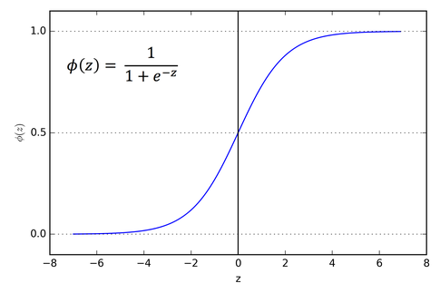
Sigmoid Function
Why use?
When?
Output between 0 and 1.
It is a monotonically increasing function, meaning as the input increases, the output also increases.
In binary classification tasks, the sigmoid function is commonly used in the output layer to predict the probability of the positive class.
Because the sigmoid function outputs values between 0 and 1, it is well-suited for tasks that require a probabilistic interpretation of the output.

Slide 8
Sigmoid Function - Example
Suppose you are building a neural network to predict whether an email is spam or not spam (binary classification).
Utilization of Sigmoid Function:
Output Layer: Use the sigmoid function in the output layer.
Reason: The sigmoid function maps any input to a value between 0 and 1, which can be interpreted as a probability. For binary classification, it outputs a probability that the input email is spam.
Why Sigmoid: It provides a clear probabilistic interpretation, making it easy to classify the email based on a threshold (e.g., if the output is greater than 0.5, classify as spam).
Why Not Others:
ReLU: Not suitable for producing probabilities between 0 and 1.
Tanh: Outputs range from -1 to 1, not ideal for probability interpretation.
Softmax: More appropriate for multi-class classification.
Binary Step: Too abrupt, doesn’t provide probabilistic output.

Slide 9
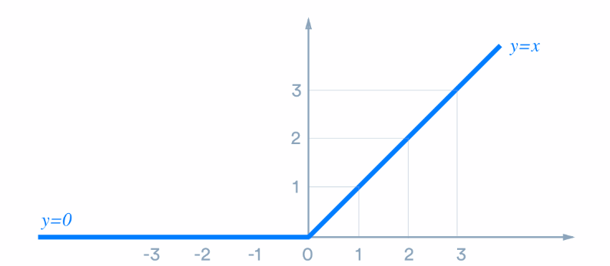
ReLu (Recitifier Linear Unit) or Rectifier Function
Why use?
When?
Output is 0 when input is 0 or negative, positive inputs remain unchanged.
Function f(x) = max(x,0) having non-linearity.
The ReLU function is computationally efficient because it involves simple thresholding at zero, making it fast to compute.
ReLU is preferred due to its effectiveness in training and its ability to mitigate the vanishing gradient problem.
ReLU is a solid default choice for activation functions in hidden layers.

Slide 10
ReLu Function - Example
Suppose you are building a convolutional neural network (CNN) for image recognition.
Utilization of ReLU Function:
Hidden Layers: Use the ReLU function in the hidden layers.
Reason: ReLU introduces non-linearity and helps the network learn complex patterns. It also mitigates the vanishing gradient problem by allowing gradients to flow when the input is positive.
Why ReLU: Efficient computation, avoids vanishing gradient problem, simple implementation.
Why Not Others:
Sigmoid/Tanh: Can suffer from vanishing gradient problems, slowing down learning.
Softmax: Not suitable for hidden layers, mainly used in output layers for classification.
Binary Step: Too abrupt, not suitable for learning complex patterns.

Slide 11
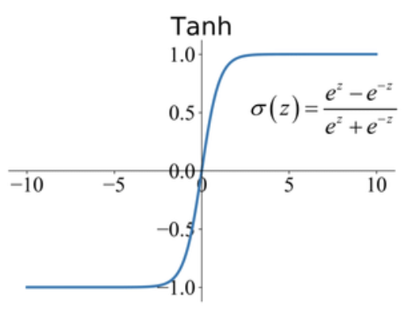
Tanh Function
Why use?
When?
Output range between -1 to 1.
The tanh function has stronger gradients than the sigmoid function for inputs in the range (-1, 1), but it can still suffer from the vanishing gradient problem for very high or very low input values.
In RNNs, tanh is often used because its zero-centered nature helps with learning sequential data and stabilizing the training process.
Tanh can be used in the encoder and decoder layers of autoencoders, particularly when the input data is normalized to the range (-1, 1).

Slide 12
Tanh Function - Example
Scenario: Time Series Prediction
Suppose you are building a neural network to predict stock prices (regression task).
Utilization of Tanh Function:
Hidden Layers: Use the tanh function in the hidden layers.
Reason: Tanh outputs range from -1 to 1, which helps in normalizing data and handling both positive and negative values symmetrically.
Why Tanh: Zero-centered outputs help in faster convergence and better weight updates.
Why Not Others:
Sigmoid: Outputs between 0 and 1, not zero-centered.
ReLU: Can lead to dead neurons; all negative inputs map to zero.
Softmax: Not suitable for hidden layers or regression tasks.
Binary Step: Not suitable for learning continuous-valued predictions.

Slide 13
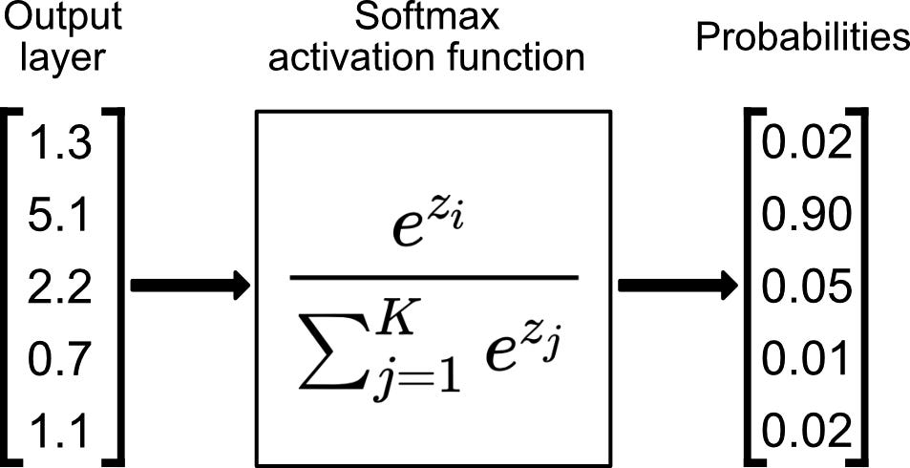
Softmax Function
Why use?
When?
Converts real values into probabilities.
It is only used as output layer for neural network.
The higher probability will be the actual output.
When the classes are mutually exclusive, meaning each instance can belong to only one class, Softmax is appropriate.
When you require normalized outputs that sum to 1, ensuring that the results can be interpreted as probabilities.

Slide 14
Softmax Function - Example
Scenario: Multi-Class Classification
Suppose you are building a neural network to classify handwritten digits (0-9) using the MNIST dataset.
Utilization of Softmax Function:
Output Layer: Use the softmax function in the output layer.
Reason: Softmax converts logits to a probability distribution, where the sum of probabilities for all classes equals 1.
Why Softmax: Provides a clear probabilistic interpretation for multi-class classification.
Why Not Others:
Sigmoid: Better for binary classification, not multi-class.
ReLU/Tanh: Not suitable for producing a probability distribution.
Binary Step: Not suitable for multi-class output.

